Slide 1
Number Theoretic Notations GCD MODULAR ARITHMETIC

Slide 2
Objectives
To review integer arithmetic, concentrating on divisibility and finding the GCD using Euclidean algorithm.
To understand how the extended Euclidean algorithm can be used to solve linear Diophantine equations.
To emphasize the importance of modular arithmetic and the modulo operators.

Slide 3
Integer Arithmetic
In integer arithmetic, we use a set and a few operations.
Reviewed here to create a background for modular arithmetic.

Slide 4

Set of Integers
The set of integers, denoted by Z, contains all integral numbers (with no fraction) from negative infinity to positive infinity
The set of integers

Slide 5
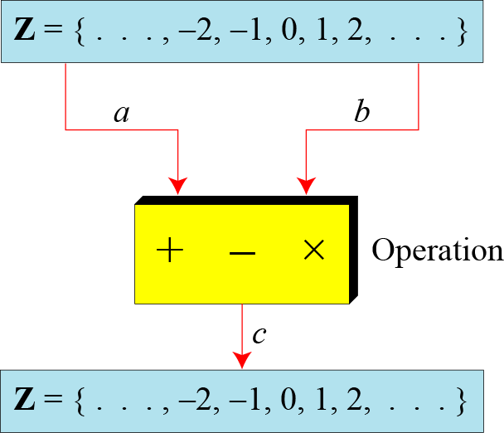
Binary Operations
In cryptography, we are interested in three binary operations applied to the set of integers. division?
A binary operation takes two inputs and creates one output.
The set of integers
Three binary operations for the set of integers

Slide 6
Integer Division
In integer arithmetic, if we divide a by n, we can get q and r.
The relationship between these four integers can be shown as
a = q × n + r
a= dividend
n= divisor
q= quotient
r= remainder

Slide 7
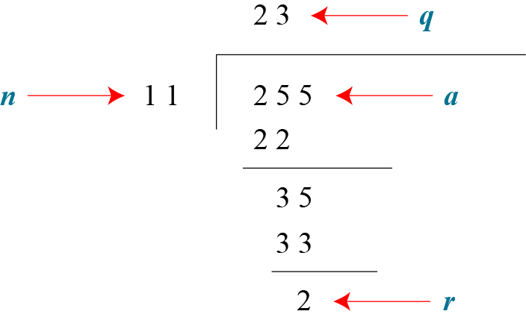
Integer Division(cont.)
Assume that a = 255 and n = 11. We can find q = 23 and r = 2 using the division algorithm.
How to find the quotient and the remainder using language specific operators??? <in case of C language>
Finding the quotient and the remainder

Slide 8
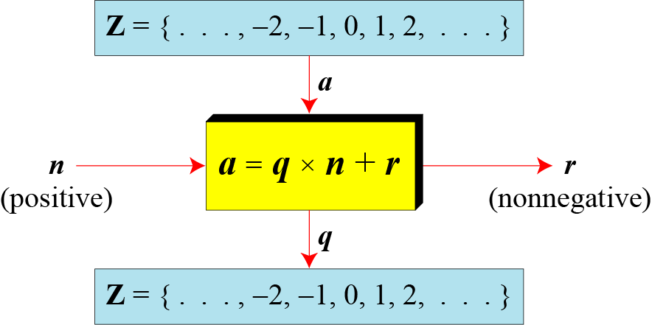
Integer Division(cont.)
In case of division relationship in cryptography, we impose two restrictions.
We require that divisor be a positive integer ( )
We require that the remainder be a nonnegative integer ( )
Division algorithm for integers

Slide 9
Integer Division(cont.)
When we use a computer or a calculator, r and q are negative when a is negative.
How can we apply the restriction that r needs to be positive?
The solution is simple, we decrement the value of q by 1 and we add the value of n to r to make it positive.
The above relation is still valid.

Slide 10
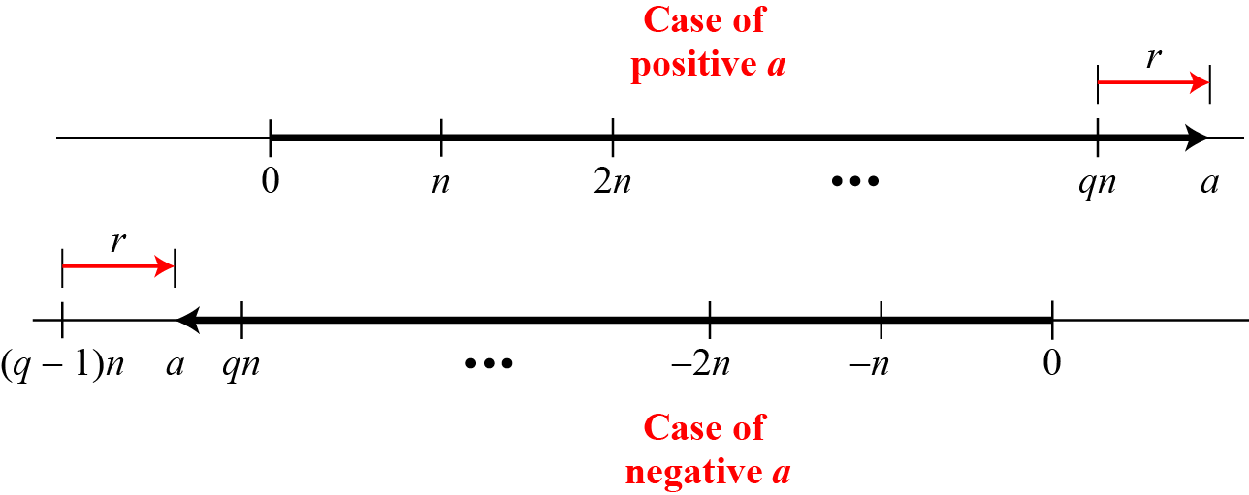
Integer Division(cont.)
Graph of division algorithm
If a is positive- move q×n units to right and move extra r units in the same direction.
If a is negative- move (q-1)×n units to the left (q is negative in this case) and then r units in the opposite direction. <in both cases the value of r is positive>

Slide 11
Divisibility
If a is not zero and we let r = 0 in the division relation, we get
If the remainder is zero, (n divides a)
If the remainder is not zero, n a (n does not divides a)
a = q × n

Slide 12
Divisibility(cont.)
Properties
Property 1: if a|1, then a = ±1.
Property 2: if a|b and b|a, then a = ±b.
Property 3: if a|b and b|c, then a|c.
Property 4: if a|b and a|c, then a|(m × b + n × c), where m and n are arbitrary integers

Slide 13
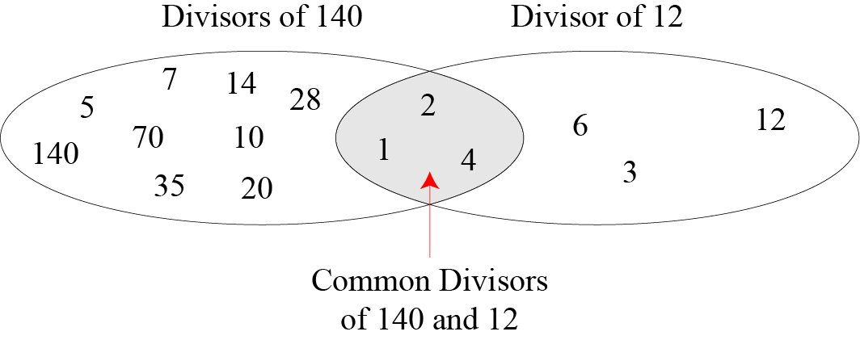
Divisibility(cont.)
Common divisors of two integers

Slide 14
Divisibility(cont.)
Greatest Common Divisor
The greatest common divisor of two positive integers is the largest integer that can divide both integers.
Euclidean Algorithm
Fact 1: gcd (a, 0) = a Fact 2: gcd (a, b) = gcd (b, r), where r is the remainder of dividing a by b

Slide 15
Divisibility(cont.)
For example, to calculate the gcd(36,10), we use following steps:
gcd (36, 10) = gcd (10, 6)……..by fact 2
gcd (10, 6) = gcd (6, 4)…………by fact 2
gcd (6, 4) = gcd (4, 2)………….by fact 2
gcd (4, 2) = gcd (2, 0)…………by fact 2
gcd (2, 0) = 2…………………….by fact 1
Hence, Answer = 2

Slide 16
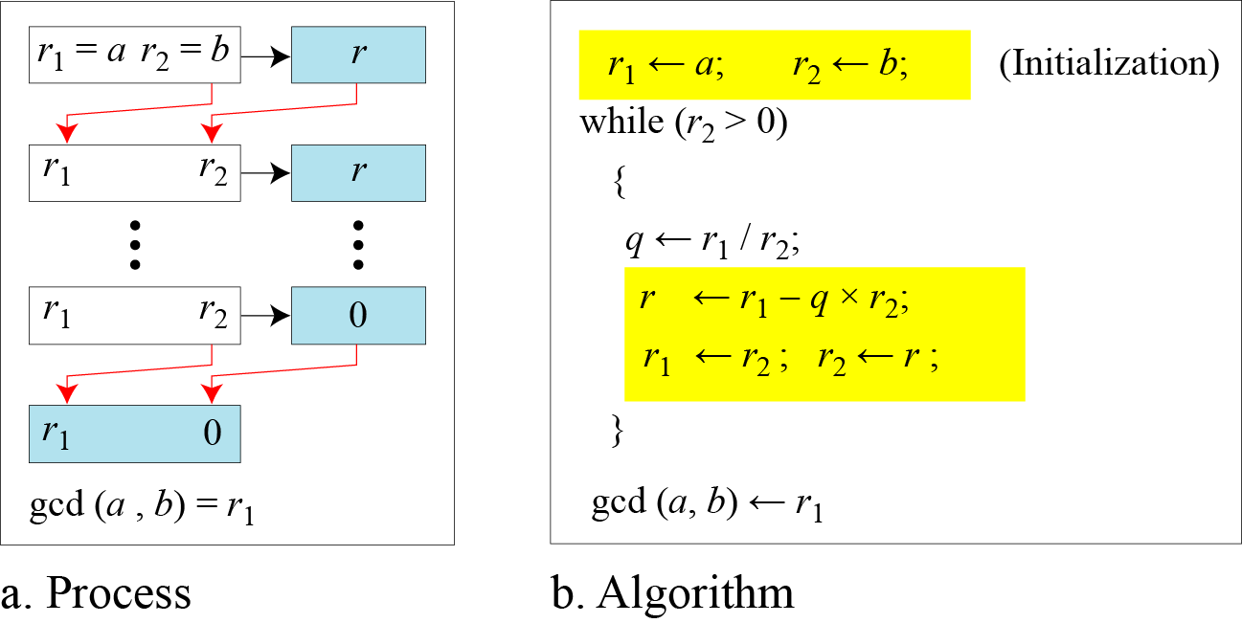
Divisibility(cont.)
Euclidean Algorithm:
- Two variables, r1 and r2, to hold the changing values during the process of reduction.
When gcd (a, b) = 1, we say that a and b are relatively prime.

Slide 17
Divisibility(cont.)
Find the greatest common divisor of 2740 and 1760.
Answer: gcd (2740, 1760) = 20.

Slide 18
Divisibility(cont.)
Find the greatest common divisor of 25 and 60.

Slide 19

Divisibility(cont.)
Extended Euclidean Algorithm
Given two integers a and b, we often need to find other two integers, s and t, such that
The extended Euclidean algorithm can calculate the gcd (a, b) and at the same time calculate the value of s and t.

Slide 20
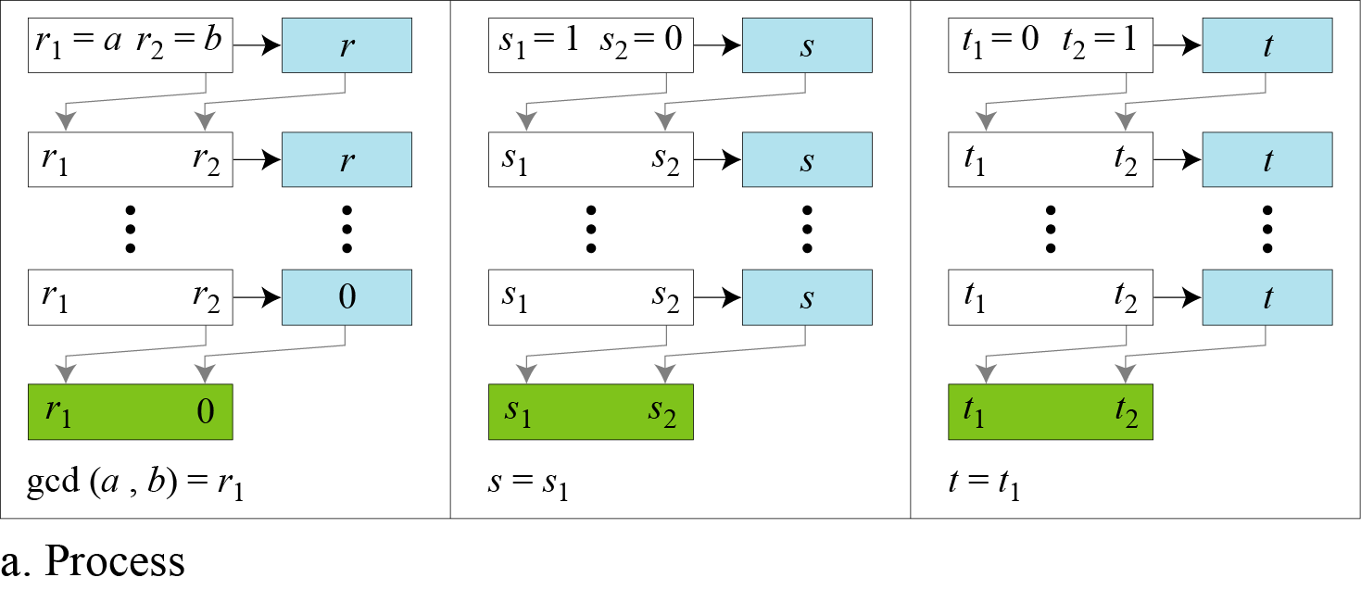
Divisibility(cont.)
Extended Euclidean algorithm, part a- <use of three set of variables, r’s, s’s, and t’s> , <only one quotient q, which is used in other two calculations>

Slide 21
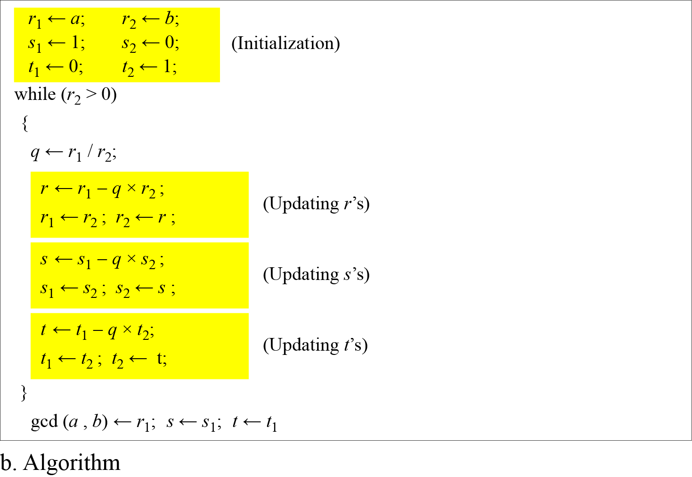
Divisibility(cont.)
Extended Euclidean algorithm, part b

Slide 22
Divisibility(cont.)
Given a = 161 and b = 28, find gcd (a, b) and the values of s and t.
Solution
We get gcd (161, 28) = 7, s = −1 and t = 6.

Slide 23
Divisibility(cont.)
Given a = 17 and b = 0, find gcd (a, b) and the values of s and t.
Solution
We get gcd (17, 0) = 17, s = 1, and t = 0

Slide 24
Divisibility(cont.)
Given a = 0 and b = 45, find gcd (a, b) and the values of s and t.
Solution
We get gcd (0, 45) = 45, s = 0, and t = 1.

Slide 25
Divisibility(cont.)
Exercise:
Given a = 84 and b = 320, find gcd (a, b) and the values of s and t.

Slide 26
Divisibility(cont.)
Exercise:
Given a = 84 and b = 320, find gcd (a, b) and the values of s and t.
Solution:
gcd(84,320) = 4, s = -19, t = 5

Slide 27
Linear Diophantine Equations
A linear Diophantine equation of two variables is,
ax + by = c.
We want to find integer values for x and y that satisfy the equation.
Either no solution or an infinite number of solutions
Let d = gcd(a,b); if d | c, the equation has no solution.
If d | c, the equation has infinite number of solutions : one of them is particular and the rest are general

Slide 28
Linear Diophantine Equations(cont.)
Particular Solution: ax + by = c
If d│c, a particular solution to the above equation can be found using
Following steps:
Reduce the equation to by dividing both sides of the equation by d. This is possible because d divides a, b, and c by the assumption.
Solve for s and t in the relation using the extended Euclidean Algorithm.
The particular solution can be found:
Particular solution: x₀ = (c/d)s and y₀ = (c/d)t

Slide 29
Linear Diophantine Equations(cont.)
General Solution:
After finding the particular solution, the general solutions can be found:
General solutions:
x = x₀ + k (b/d) and y = y₀ − k(a/d) where k is an integer

Slide 30
Linear Diophantine Equations(cont.)
Example:
Find the particular and general solutions for the equation
21x + 14y = 35.
Particular solution: x₀ = (c/d)s and y₀ = (c/d)t
General solutions:
x = x0 + k (b/d) and y = y0 − k(a/d) where k is an integer

Slide 31
Linear Diophantine Equations(cont.)
Example:
Find the particular and general solutions for the equation
21x + 14y = 35.
Solution:
d= gcd (21,14)= 7, since 7I35
We have s=1 and t= -1
Particular solution: (x₀, y₀) = (5, -5)
General solutions : (5,-5), (7,-8), (9,-11) …
Particular solution: x₀ = (c/d)s and y₀ = (c/d)t
General solutions:
x = x0 + k (b/d) and y = y0 − k(a/d) where k is an integer

Slide 32
Linear Diophantine Equations(cont.)
Example:
Imagine we want to cash a Rs.100 cheque and get some Rs.20 notes and some Rs.5 notes.
Find out the possible choices if any exist for the given problem
Particular solution: x₀ = (c/d)s and y₀ = (c/d)t
General solutions:
x = x0 + k (b/d) and y = y0 − k(a/d) where k is an integer

Slide 33
Linear Diophantine Equations(cont.)
Solution:
20 x+ 5 y= 100
Since d= gcd(20,5) and 5 divides 100
Divide both sides by 5 to get 4x +y= 20
Then solve the equation
4s+ t= 1
Where,
S=0, and t=1 using the extended Euclidean algorithm
The particular solutions are x₀ = 0 × 20= 0 and y₀=1 × 20= 20
The general solutions with x and y nonnegative are (0, 20), (1,16), (2, 12), (3, 8), (4, 4), (5, 0)
Particular solution: x₀ = (c/d)s and y₀ = (c/d)t
General solutions:
x = x0 + k (b/d) and y = y0 − k(a/d) where k is an integer

Slide 34
Modular Arithmetic

Slide 35
Preliminary
The division relationship (a = q × n + r) discussed in the previous section has two inputs (a and n) and two outputs (q and r).
In modular arithmetic, we are interested in only one of the outputs, the remainder r.

Slide 36
Preliminary(cont.)
We use modular arithmetic in our daily life; for example, we use a clock to measure time. Our clock system uses modulo 12 arithmetic. However, instead of a 0 we use the number 12.

Slide 37
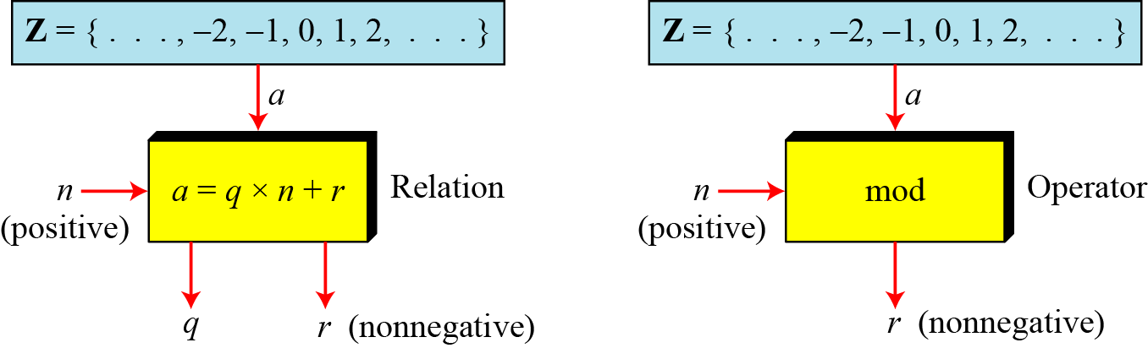
Modulo Operator
The modulo operator is shown as mod. The second input (n) is called the modulus. The output r is called the residue.
Division algorithm and modulo operator

Slide 38
Modulo Operator(cont.)
Find the result of the following operations:
27 mod 5
36 mod 12
−18 mod 14
−7 mod 10

Slide 39
Modulo Operator(cont.)
Solution
Dividing 27 by 5 results in r = 2
Dividing 36 by 12 results in r = 0
Dividing −18 by 14 results in r = −4. After adding the modulus r = 10
Dividing −7 by 10 results in r = −7. After adding the modulus to −7, r = 3

Slide 40
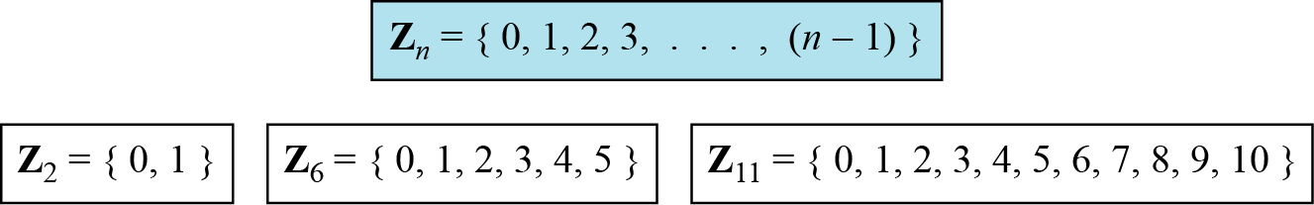
Set of Residues : Z_{n}
The results of the modulo operation with modulus n is always an integer between 0 and n-1. <i.e. result of a mod n is always a nonnegative integer >
The modulo operation creates a set, which in modular arithmetic is referred to as the set of least residues modulo n, or Z_{n}.
Some Z_{n} sets

Slide 41
Congruence
In cryptography, we often used the concept of congruence instead of equality.
To show that two integers are congruent, we use the congruence operator ( ≡ ).
We say that a is congruent to b modulo m, and we write a ≡ b mod m, if m divides b-a.
Example:

Slide 42
Congruence(cont.)
Congruence operator Vs. equality operator
A equality operator maps a member of Z to itself,
The congruence operator maps a member from Z to member of Z_{n}.
The equality operator is one-to-one,
The congruence operator is many-to-one
The phrase (mod n) is an indication of destination set Z_{n}. <Example- 2 ≡ 12 (mod 10), means that the destination set is Z₁₀.>

Slide 43
Congruence(cont.)
Properties-
a ≡ b mod m, implies that b ≡ a mod m (symmetry)
a ≡ b mod m and b ≡ c mod m, implies that a ≡ c mod m (transitivity)

Slide 44
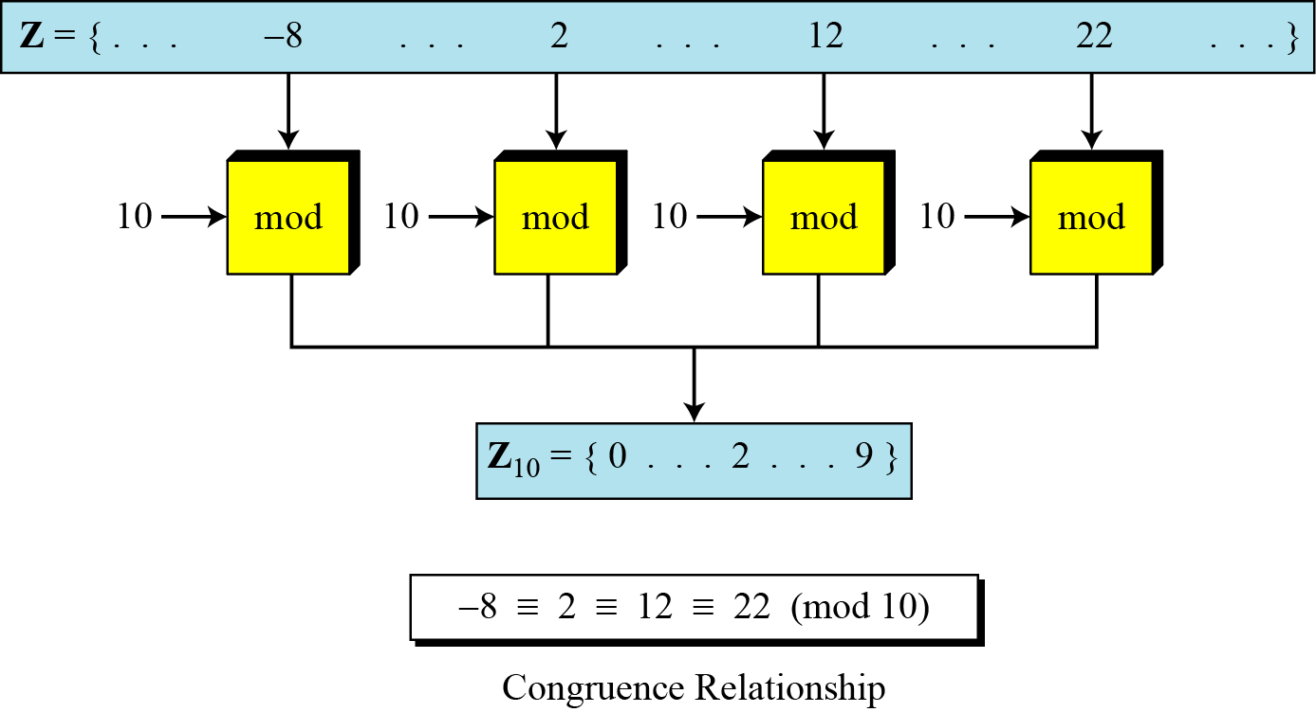
Congruence(cont.)

Slide 45
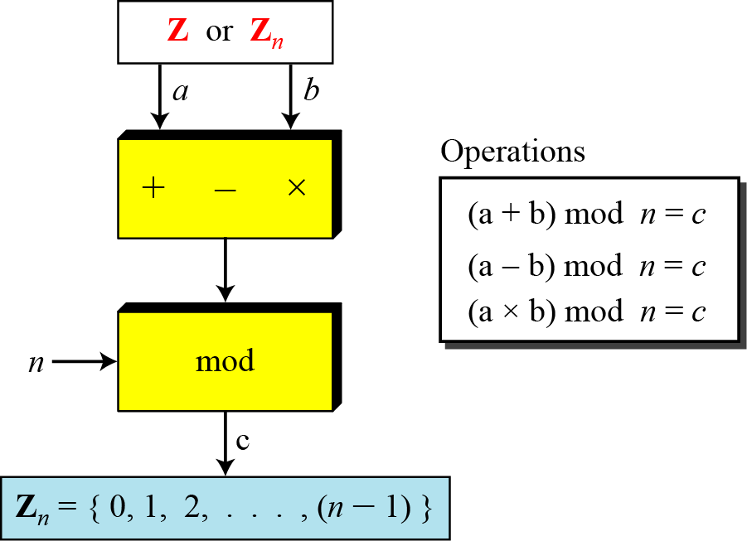
Operation in Zn
The three binary operations that we discussed for the set Z can also be defined for the set Zn. The result may need to be mapped to Zn using the mod operator.

Slide 46
Operation in Z_{n}(cont.)
Perform the following operations (the inputs come from Z_{n}):
a. Add 7 to 14 in Z₁₅.
b. Subtract 11 from 7 in Z₁₃.
c. Multiply 11 by 7 in Z₂₀.

Slide 47
Operation in Z_{n}(cont.)
Solution

Slide 48
Operation in Z_{n}(cont.)
Perform the following operations (the inputs come from either Z or Z_{n}):
a. Add 17 to 27 in Z₁₄.
b. Subtract 43 from 12 in Z₁₃.
c. Multiply 123 by −10 in Z₁₉.

Slide 49
Operation in Z_{n}(cont.)
Solution
Add 17 to 27 in Z₁₄.
(17+27)mod 14 = 2
Subtract 43 from 12 in Z₁₃.
(12-43)mod 13 = 5
Multiply 123 by −10 in Z₁₉.
(123 x (-10)) mod 19 = 5

Slide 50
Operation in Z_{n}(cont.)

Slide 51
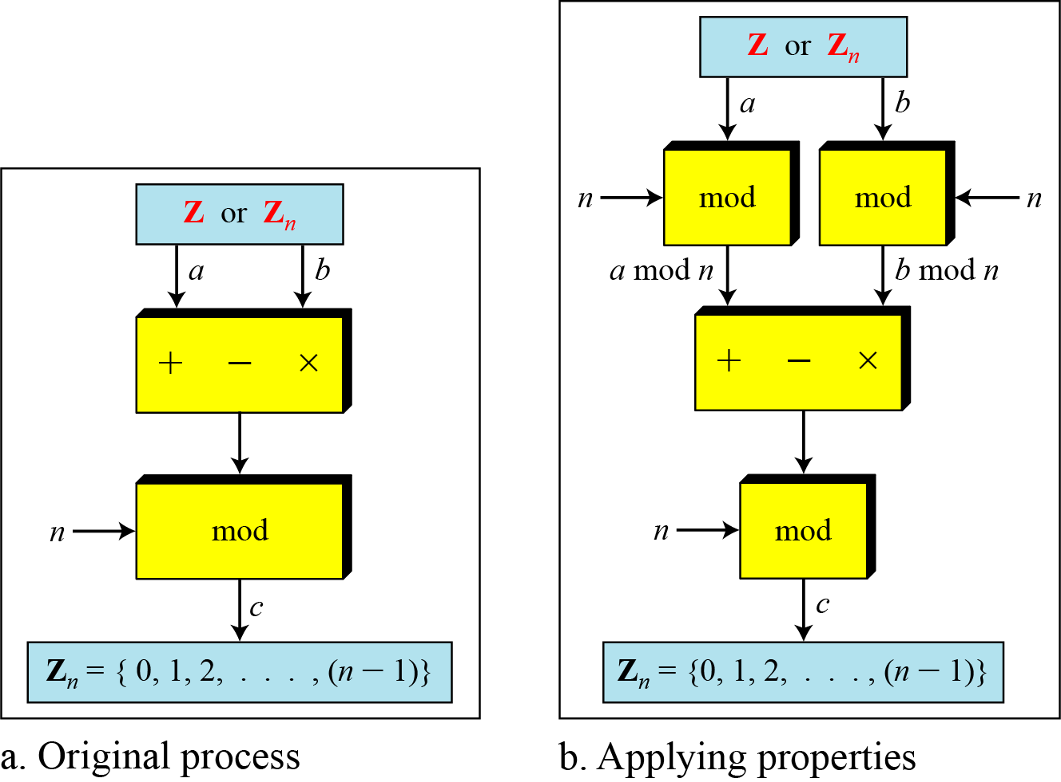
Operation in Z_{n}(cont.)

Slide 52
Operation in Z_{n}(cont.)
The following shows the application of the above properties:
1. (1,723,345 + 2,124,945) mod 11 = (8 + 9) mod 11 = 6
2. (1,723,345 − 2,124,945) mod 16 = (8 − 9) mod 11 = 10
3. (1,723,345 × 2,124,945) mod 16 = (8 × 9) mod 11 = 6

Slide 53
Inverses
Working in modular arithmetic, we often need to find the inverse of a number relative to an operation.
additive inverse (relative to an addition operation) or
a multiplicative inverse (relative to a multiplication operation).

Slide 54
Inverses- relevancy with cryptography
In cryptography we often work with inverses.
If the sender uses an integer (as the encryption key), the receiver uses the inverse of that integer (as the decryption key).
If the operation (encryption/decryption algorithm) is addition, Zn can be used as the set of possible keys because each integer in this set has an additive inverse.
On the other hand, if the operation (encryption/decryption algorithm) is multiplication , Zn cannot be the set of possible keys because only some numbers of this set have a multiplicative inverse.

Slide 55

Additive Inverses
In Z_{n}, two numbers a and b are additive inverses of each other if
In modular arithmetic, each integer has an additive inverse. The sum of an integer and its additive inverse is congruent to 0 modulo n.

Slide 56
Additive Inverses
Find additive inverse of 4 in Z₁₀.
Solution
In Z_{n} , the additive inverse of a can be calculated as b=n – a.
The additive inverse 4 in Z₁₀ is 10-4=6 .

Slide 57
Additive Inverses
Find all additive inverse pairs in Z₁₀.
Solution
The six pairs of additive inverses are (0, 0), (1, 9), (2, 8), (3, 7), (4, 6), and (5, 5).

Slide 58

Multiplicative Inverses
In Z_{n}, two numbers a and b are the multiplicative inverse of each other if,
In modular arithmetic, an integer may or may not have a multiplicative inverse.
When it does, the product of the integer and its multiplicative inverse is congruent to 1 modulo n.

Slide 59
Multiplicative Inverses(cont.)
Find the multiplicative inverse of 8 in Z₁₀.
There is no multiplicative inverse because gcd (10, 8) = 2 ≠ 1.
In other words, we cannot find any number between 0 and 9 such that when multiplied by 8, the result is congruent to 1.
Find all multiplicative inverses in Z₁₀.
There are only three pairs: (1, 1), (3, 7) and (9, 9). The numbers 0, 2, 4, 5, 6, and 8 do not have a multiplicative inverse.

Slide 60
Multiplicative Inverses(cont.)
Find all multiplicative inverse pairs in Z₁₁.

Slide 61
Multiplicative Inverses(cont.)
Find all multiplicative inverse pairs in Z₁₁.
Solution
We have seven pairs: (1, 1), (2, 6), (3, 4), (5, 9), (7, 8), (9, 9), and (10, 10).
The reason is that in Z₁₁ , gcd (11,a) is 1 (relatively prime) for all value of a except 0. it means all integers 1 to 10 have multiplicative inverse.

Slide 62
Multiplicative Inverses(cont.)
The extended Euclidean algorithm finds the multiplicative inverses of b in Z_{n} when n and b are given and gcd (n, b) = 1.
The multiplicative inverse of b is the value of t1 after being mapped to Z_{n}.

Slide 63
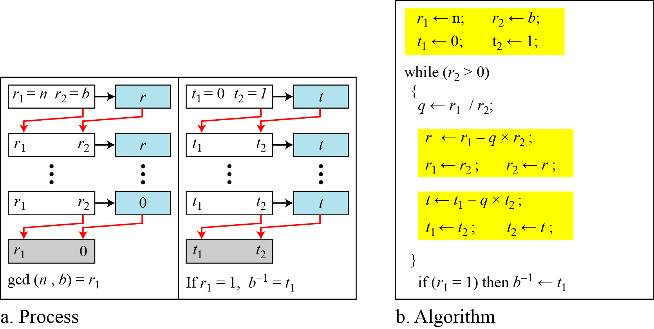
Multiplicative Inverses(cont.)
Using extended Euclidean algorithm to find multiplicative inverse

Slide 64
Multiplicative Inverses(cont.)
Find the multiplicative inverse of 11 in Z₂₆.
Solution
The gcd (26, 11) is 1; the inverse of 11 is -7 or 19.

Slide 65
Multiplicative Inverses(cont.)
Find the multiplicative inverse of 23 in Z₁₀₀.

Slide 66
Multiplicative Inverses(cont.)
Find the multiplicative inverse of 23 in Z₁₀₀.
Solution
The gcd (100, 23) is 1; the inverse of 23 is -13 or 87.

Slide 67
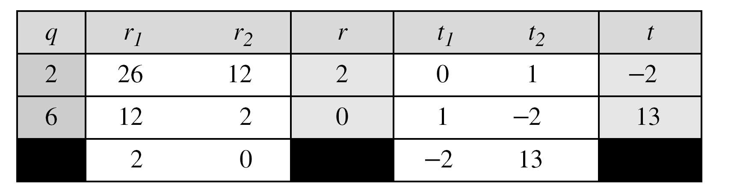
Multiplicative Inverses(cont.)
Find the multiplicative inverse of 12 in Z₂₆.
Solution
The gcd (26, 12) is 2; the inverse does not exist.

Slide 68
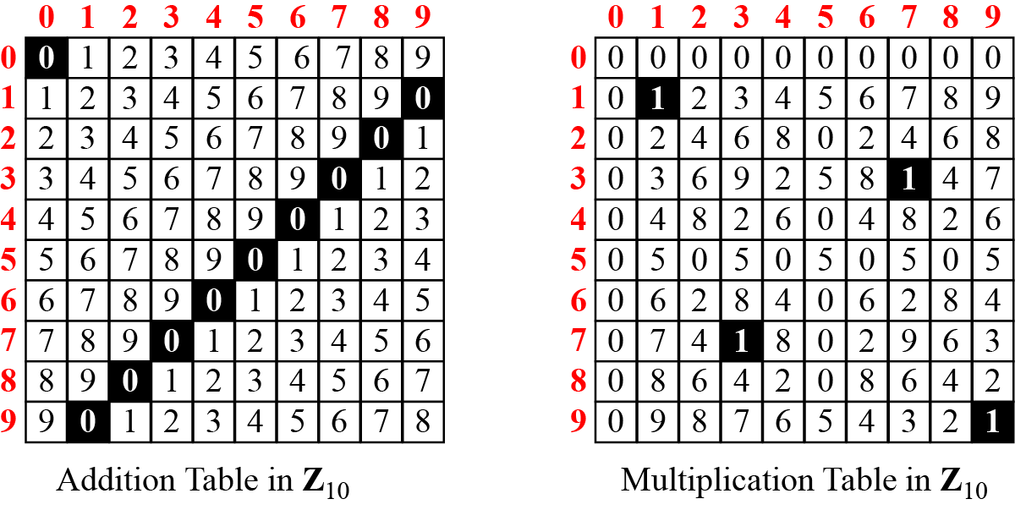
Addition and Multiplication Tables
Addition and multiplication table for Z₁₀
Additive Inverse: Inverse pair can be found when the result of addition is zero.
Multiplicative Inverse: Inverse pair can be found when the result of multiplication is 1.

Slide 69
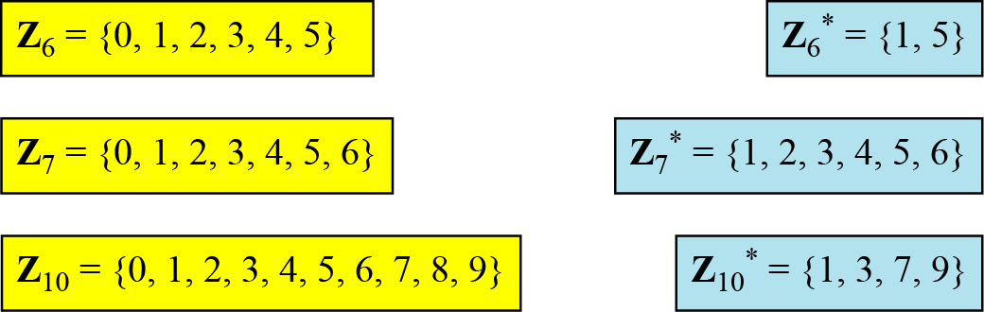
Different Sets of Addition and Multiplication
Some Z_{n} and Z_{n}* sets
We need to use Z_{n} when additive inverses are needed; we need to use Z_{n}* when multiplicative inverses are needed.

